Slide 1
Advanced White-box Testing Techniques
Naseem us Sehar

Slide 2
Mutation Testing
Mutation Testing is a type of software testing in which certain statements of the source code are changed/mutated to check if the test cases are able to find errors in source code. The goal of Mutation Testing is ensuring the quality of test cases in terms of robustness that it should fail the mutated source code.
The changes made in the mutant program should be kept extremely small that it does not affect the overall objective of the program. Mutation Testing is also called Fault-based testing strategy as it involves creating a fault in the program and it is a type of White Box Testing which is mainly used for Unit Testing.

Slide 3
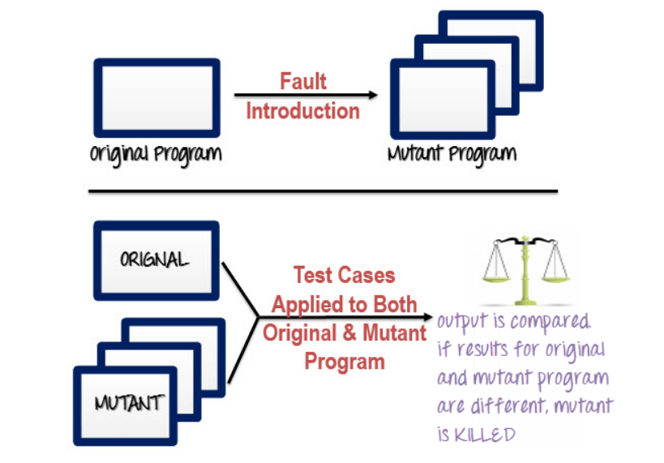
Mutation Testing

Slide 4
Mutation Testing concepts
#1) Mutants: It is simply the mutated version of the source code. It is the code that contains minute changes. When the test data is run through the mutant, it should ideally give us different results from the original source code. Mutants are also called mutant programs.
There are different types of mutants. These are as follows:
Survived Mutants: As we have mentioned, these are the mutants that are still alive after running test data through the original and mutated variants of the source code. These must be killed. They are also known as live mutants.
Killed Mutants: These are mutants that are killed after mutation testing. We get these when we get different results from the original and mutated versions of the source code.
Equivalent Mutants: These are closely related to live mutants, in that, they are ‘alive’ even after running test data through them. What differentiates them from others is that they have the same meaning as the original source code, even though they may have different syntax.

Slide 5
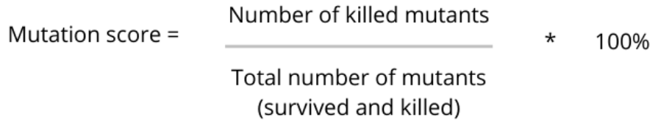
Mutation Testing concepts
#2) Mutators/mutation operators: These are what makes mutations possible, they are on the ‘driver’s seat’. They basically define the kind of alteration or change to make to the source code to have a mutant version. They can be referred to as faults or mutation rules.
#3) Mutation score: This is a score based on the number of mutants.

Slide 6
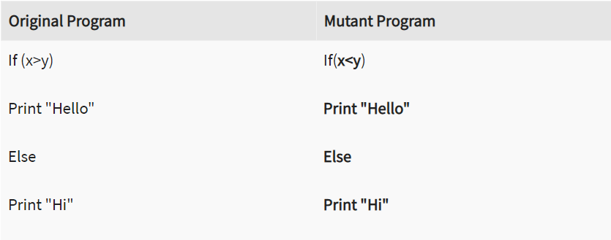
Example

Slide 7
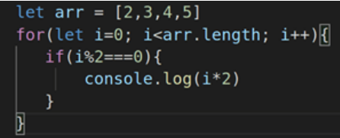
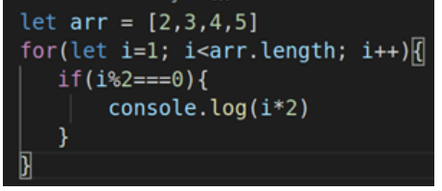
Mutation Testing Types
Value Mutation- values of primary parameters are modified
Above image contains the original code whereas second image contains mutant code

Slide 8
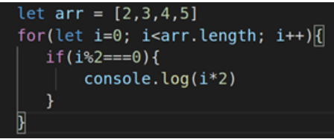
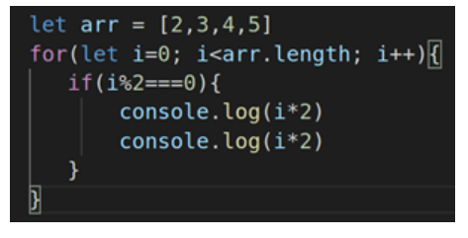
Mutation testing types
#2) Statement Mutation
Here, we delete or duplicate a statement in a code block. We could also rearrange statements in a code block.

Slide 9
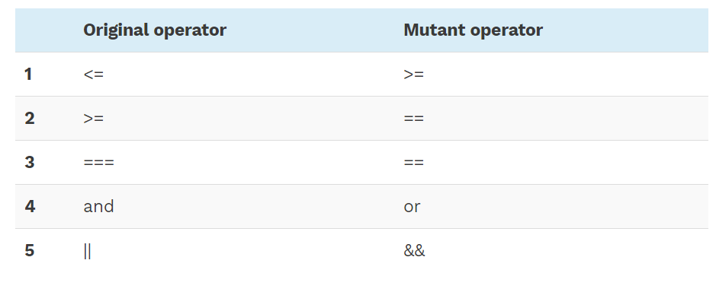
Mutation Testing Types
#3) Decision Mutation
The target here is the code that makes decisions, for example, value comparisons.

Slide 10
Advantages of Mutation Testing
It is a powerful approach to attain high coverage of the source program.
This testing is capable comprehensively testing the mutant program.
Mutation testing brings a good level of error detection to the software developer.
This method uncovers ambiguities in the source code and has the capacity to detect all the faults in the program.
Customers are benefited from this testing by getting a most reliable and stable system.

Slide 11
Disadvantages of Mutation Testing
Mutation testing is extremely costly and time-consuming since there are many mutant programs that need to be generated.
Since its time consuming, it's fair to say that this testing cannot be done without an automation tool.
Each mutation will have the same number of test cases than that of the original program. So, a large number of mutant programs may need to be tested against the original test suite.
As this method involves source code changes, it is not at all applicable for Black Box Testing.

Slide 12
Mutation testing
Rest of the topic will be covered from book from section 3.5

